Slide 1

Dept. of Computer Science and Engineering
University of Rajshahi
www.ru.ac.bd
Dr. Shamim Ahmad

Slide 2
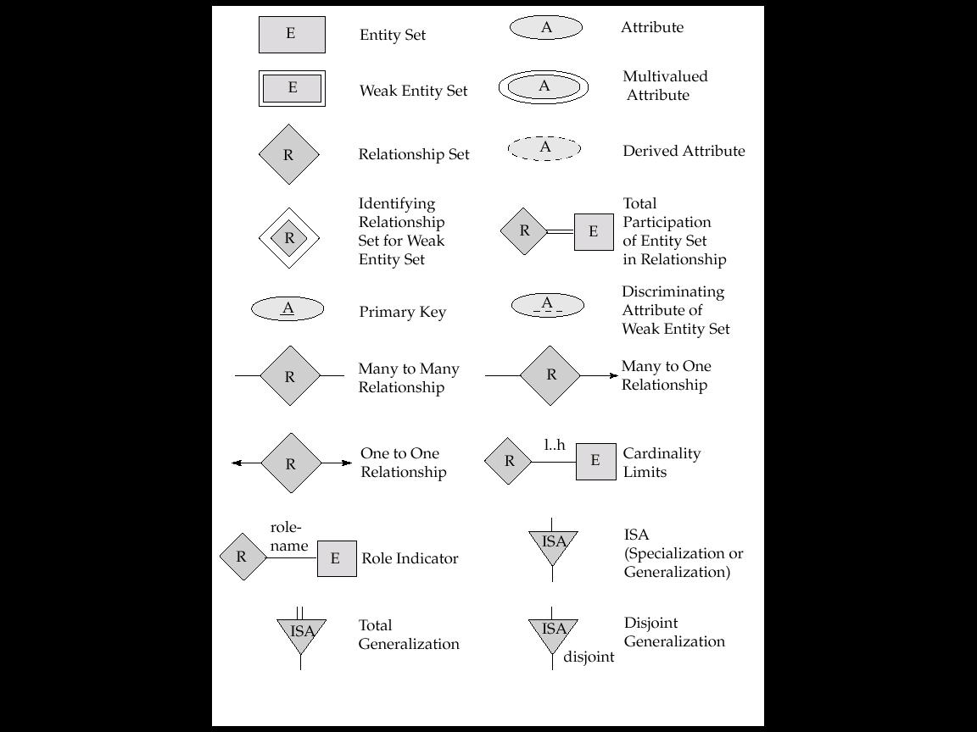
Extended E-R Features (Cont.)
Alternative E-R Notations

Slide 3
Extended E-R Features (Cont.)

Slide 4
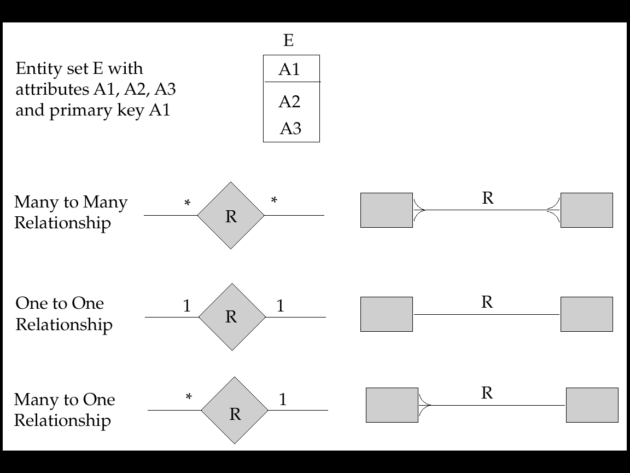
Extended E-R Features (Cont.)

Slide 5
Design of an E-R Database Schema
Among the designer’s decisions are:
The use of an attribute or entity set to represent an object.
Whether a real-world concept is best expressed by an entity set or a relationship set.
The use of a ternary relationship versus a pair of binary relationships.
The use of a strong or weak entity set.
The use of specialization/generalization – contributes to modularity in the design.
The use of aggregation – can treat the aggregate entity set as a single unit without concern for the details of its internal structure.

Slide 6
Design of an E-R Database Schema (Cont.)
Design Phases
Conceptual-design(specification of functional requirements)
Logical-design phases
Physical-design phase
Database design for Banking Enterprise
Data Requirements
The bank is organized into branches.
Bank customers are identified by their customer-id values.
Bank employees are identified by their employee-id values.

Slide 7
Design of an E-R Database Schema (Cont.)
The bank offers two types of accounts-saving and checking accounts.
A loan originates at a particular branch and can be held by one or more customers.
Entity Sets Designation
The branch entity set.
The customer entity set.
The employee entity set.
Two account entity sets.
The loan entity set.
The weak entity set loan-payment.

Slide 8
Design of an E-R Database Schema (Cont.)
Relationship Sets Designation
borrower.
loan-branch.
loan-payment.
depositor.
cust-banker.
works-for.
E-R Diagram

Slide 9
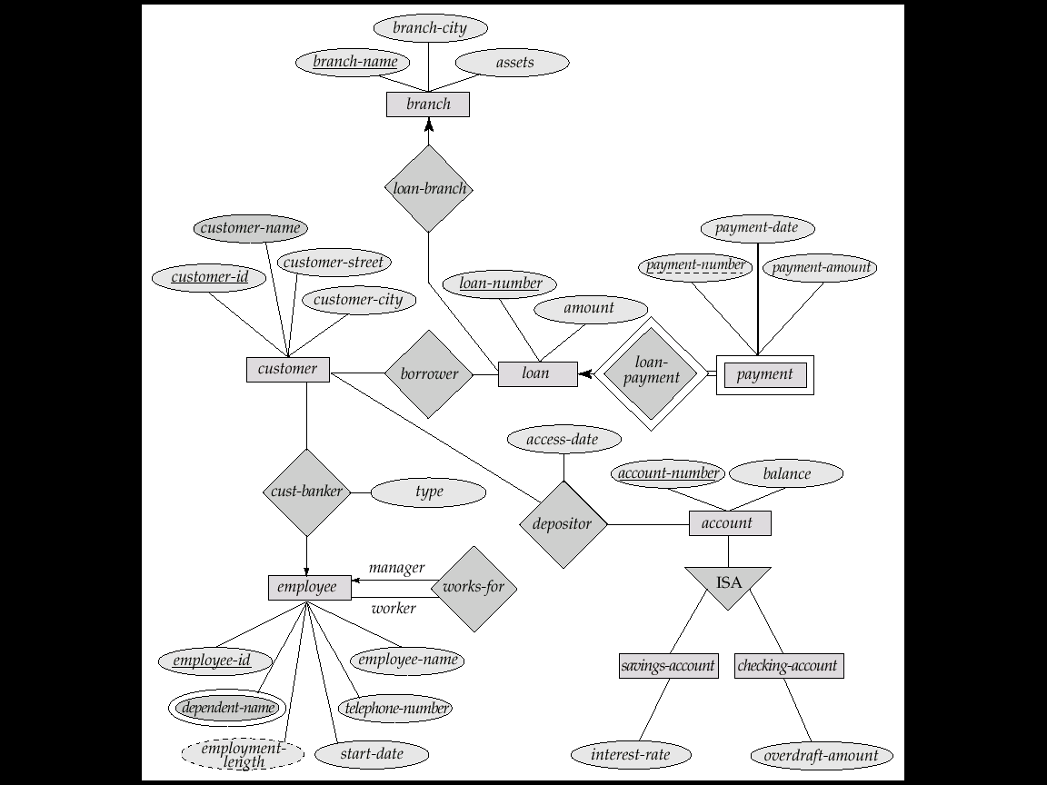
E-R Diagram for a Banking Enterprise

Slide 10
Reduction of an E-R Schema to Tables
Primary keys allow entity sets and relationship sets to be expressed uniformly as tables which represent the contents of the database.
A database which conforms to an E-R diagram can be represented by a collection of tables.
For each entity set and relationship set there is a unique table which is assigned the name of the corresponding entity set or relationship set.
Each table has a number of columns (generally corresponding to attributes), which have unique names.
Converting an E-R diagram to a table format is the basis for deriving a relational database design from an E-R diagram.

Slide 11
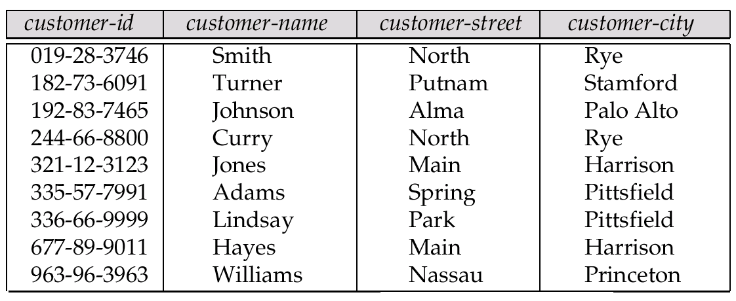
Representing strong Entity Sets as Tables
A strong entity set reduces to a table with the same attributes.

Slide 12
Representing strong Entity Sets as Tables
A strong entity set reduces to a table with the same attributes.
SID
Name
SSN
Name
Student
Advisor
Professor
Major
Dept
GPA
SID
Name
Major
GPA
SSN
Name
Dept
1234
John
CS
2.8
9999
Smith
Math
5678
Mary
EE
3.6
8888
Lee
CS

Slide 13
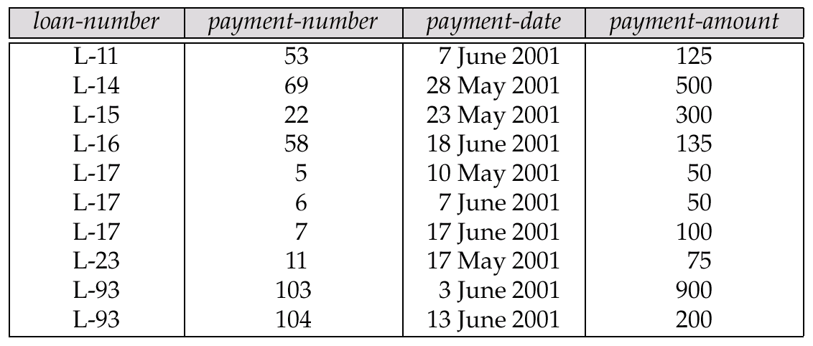
Representing Weak Entity Sets
A weak entity set becomes a table that includes a column for the primary key of the identifying strong entity set

Slide 14
Representing Weak Entity Sets
Age
SID
Name
Name
Parent
owns
Children
Phone
Addr
Age
Name
Parent_SID
10
Bart
1234
8
Lisa
5678
* Primary key of Children is Parent_SID + Name

Slide 15
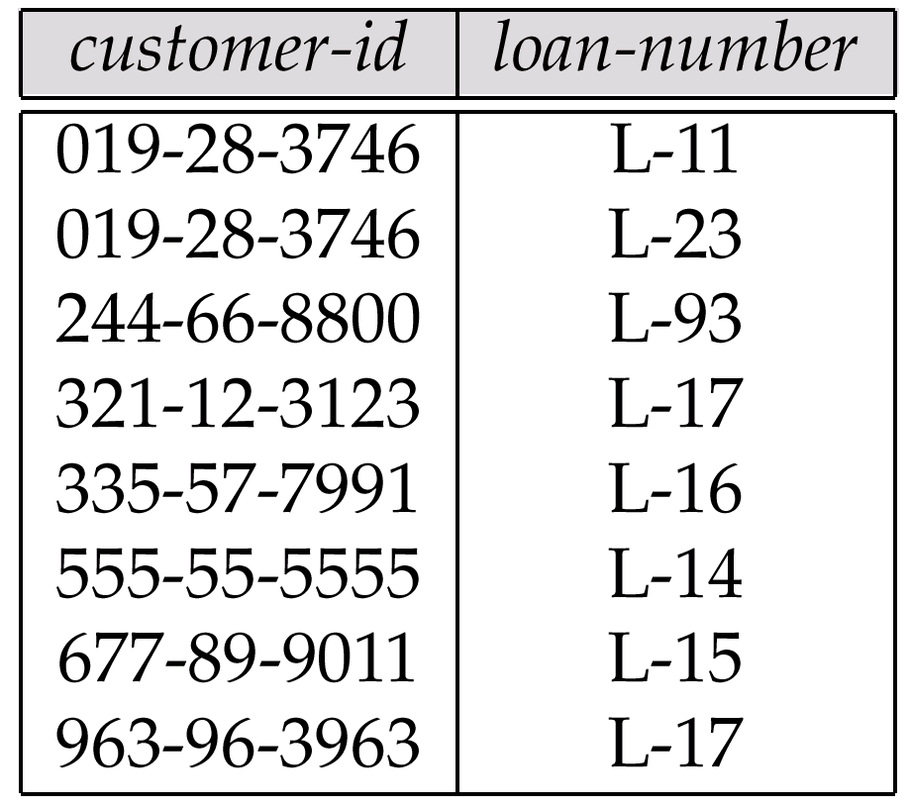
Representing Relationship Sets as Tables
A many-to-many relationship set is represented as a table with columns for the primary keys of the two participating entity sets, and any descriptive attributes of the relationship set.
E.g.: table for relationship set borrower

Slide 16
Many-to-many Relationship Sets
For many-to-many relationship
Same thing as one-to-one relationship without total participation.
Primary key of this new schema is the union of the foreign keys of both entity sets.

Slide 17
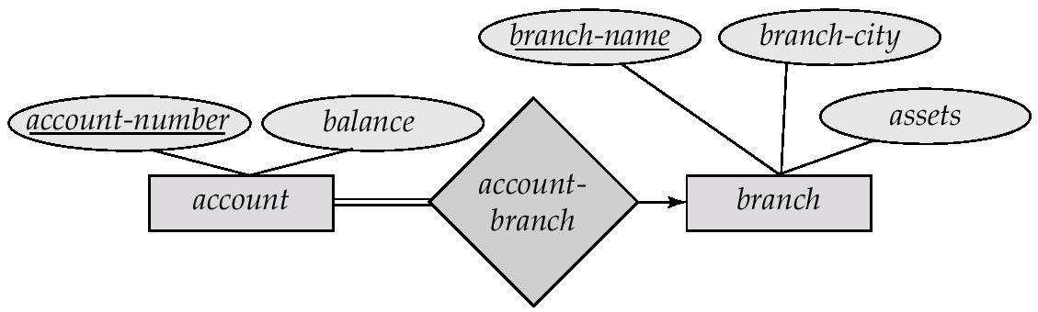
Redundancy of Tables
Many-to-one and one-to-many relationship sets that are total on the many-side can be represented by adding an extra attribute to the many side, containing the primary key of the one side
E.g.: Instead of creating a table for relationship account-branch, add an attribute branch name to the entity set account

Slide 18
Many-to-one and One-to-many
For one-to-many relationship w/out total participation
Same thing as one-to-one
For one-to-many/many-to-one relationship with one entity set having total participation on “many” side
Augment one extra column on the right side of the table of the entity set on the “many” side, put in there the primary key of the entity set on the “one” side as per to the relationship.

Slide 19
Example – Many-to-One Relationship Set
Semester
SID
Name
N:1 Relationship
SSN
Student
Advisor
Professor
Major
GPA
Dept
Name
SID
Name
Major
GPA
Pro_SSN
Ad_Sem
9999
Bart
Economy
-4.0
123-456
Fall 2006
8888
Lisa
Physics
4.0
567-890
Fall 2005
* Primary key of this table is SID

Slide 20
Redundancy of Tables (Cont.)
For one-to-one relationship sets, either side can be chosen to act as the “many” side
That is, extra attribute can be added to either of the tables corresponding to the two entity sets

Slide 21
One-to-one Relationship Set
For one-to-one relationship w/out total participation
Build a table with two columns, one column for each participating entity set’s primary key. Add successive columns, one for each descriptive attributes of the relationship set (if any).
For one-to-one relationship with one entity set having total participation
Augment one extra column on the right side of the table of the entity set with total participation, put in there the primary key of the entity set without complete participation as per to the relationship

Slide 22
Example One-to-One Relationship Set
Degree
SID
Name
ID Code
Student
study
Major
Major
GPA
SID
Maj_ID Co
S_Degree
9999
07
1234
8888
05
5678

Slide 23
Example One-to-One Relationship Set
Condition
SID
Name
1:1 Relationship
S/N #
Student
Have
Laptop
Major
GPA
Brand
SID
Name
Major
GPA
LP_S/N
Hav_Cond
9999
Bart
Economy
-4.0
123-456
Own
8888
Lisa
Physics
4.0
567-890
Loan
* Primary key can be either SID or LP_S/N

Slide 24
Composite and Multivalued Attributes
Composite attributes are flattened out by creating a separate attribute for each component attribute
E.g. given entity set customer with composite attribute name with component attributes first-name and last-name the table corresponding to the entity set has two attributes name.first-name and name.last-name

Slide 25
Composite and Multivalued Attributes
A multivalued attribute M of an entity E is represented by a separate table EM
Table EM has attributes corresponding to the primary key of E and an attribute corresponding to multivalued attribute M
Each value of the multivalued attribute maps to a separate row of the table EM

Slide 26
Representing Composite Attribute
SSN
Name
SSN
Name
Street
City
Professor
9999
Dr. Smith
50 1st St.
Fake City
8888
Dr. Lee
1 B St.
San Jose
Address
Street
City

Slide 27
Representing Multivalue Attribute
SID
Name
The primary key for this table is Student_SID + Children, the union of all attributes
Children
Student
Major
GPA
Stud_SID
Children
1234
Johnson
1234
Mary
SID
Name
Major
GPA
5678
Bart
1234
John
CS
2.8
5678
Lisa
5678
Homer
EE
3.6
5678
Maggie

Slide 28
Representing Specialization as Tables
Method 1:
Form a table for the higher level entity set
Form a table for each lower level entity set, include primary key of higher level entity set and local attributes table table attributes person name, street, city customer name, credit-rating employee name, salary
Drawback: getting information about, e.g., employee requires accessing two tables

Slide 29
Representing Specialization as Tables (Cont.)
Method 2:
Form a table for each entity set with all local and inherited attributes table table attributes person name, street, city customer name, street, city, credit-rating employee name, street, city, salary
If specialization is total, table for generalized entity (person) not required to store information
Can be defined as a “view” relation containing union of specialization tables
Drawback: street and city may be stored redundantly for persons who are both customers and employees

Slide 30
Representing Relationship Set N-ary Relationship
Intuitively Simple
Build a new table with as many columns as there are attributes for the union of the primary keys of all participating entity sets.
Augment additional columns for descriptive attributes of the relationship set (if necessary)
The primary key of this table is the union of all primary keys of entity sets that are on “many” side
That is it, we are done.

Slide 31
Representing Relationship Set N-ary Relationship
P-Key1
D-Attribute
A-Key
E-Set 1
P-Key2
A relationship
Another Set
E-Set 2
P-Key3
E-Set 3
P-Key1
P-Key2
P-Key3
A-Key
D-Attribute
9999
8888
7777
6666
Yes
1234
5678
9012
3456
No
* Primary key of this table is P-Key1 + P-Key2 + P-Key3

Slide 32
Representing Class Hierarchy
Two general approaches depending on disjointness and completeness
For disjoint AND complete mapping class hierarchy:
DO NOT create a table for the super class entity set
Create a table for each subclass entity set include all attributes of that subclass entity set and attributes of the superclass entity set

Slide 33
Example
SSN
Name
Person
SID
Status
Gender
ISA
Student
Major
GPA
SSN
Name
Gender
1234
Homer
Male
5678
Marge
Female
SSN
SID
Status
Major
GPA
1234
9999
Full
CS
2.8
5678
8888
Part
EE
3.6

Slide 34
Fourth Edition
Problem #
2.12
2.14
2.26

